Slide 1


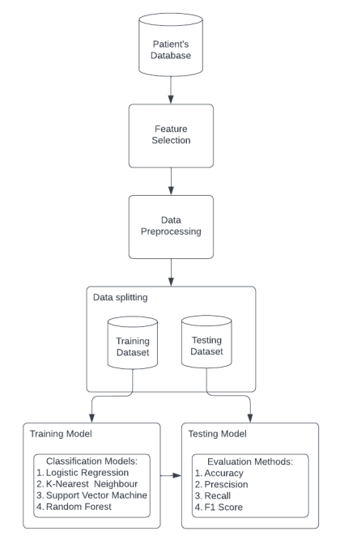
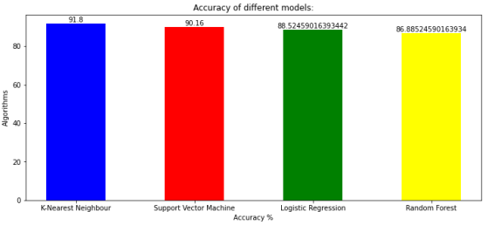
NITTE MEENAKSHI INSTITUTE OF TECHNOLOGY
(An Autonomous Institution)
DEPARTMENT OF COMPUTER SCIENCE AND ENGINEERING
TITLE OF THE PROJECT
Under the guidance of:
DR. VASANTHAKUMAR G.U , ASSOCIATE PROFESSOR
Dept. of CSE, NMIT, Bangalore
TEAM MEMBERS:
1. Anubhav Yadav 3. Neha VM
2. Kinshuk Chaturvedi 4. Muskan Khatwani
OBJECTIVES:
1. To design and build a user-friendly interface that anyone irrespective of their age or gender can use to test the heart health status.
2. To pre-process the dataset so to help boost general productivity by allowing for the accurate service possible when making decisions.
3. To select a suitable machine learning algorithm for the project with high accuracy of results.
4. to specifically mention the percentile chances of heart disease.
INTRODUCTION: Given a set of data pertaining to patients' clinical parameters, the problem is to clean the dataset and choose an appropriate algorithm which gives high accuracy in predicting the likelihood of diagnosing the patient with cardiovascular disease.
BLOCK DIAGRAM
CHARTS
RESULT: All four machine learning algorithms are assessed based on their accuracies and out of which one is selected. In order to evaluate all of the algorithms, it is expected to use numerous assessment metrics, including the confusion matrix, accuracy, precision, f1-score, recall and select one which predicts the disease efficiently. When these four are compared, the K-Nearest Neighbor model has the most accuracy of 91.80.%. Therefore, for predicting heart disease, the K-Nearest Neighbor classifier is used in the model.
FUTURE SCOPE:
▪ With the help of more dataset training on lab result variables an option to analyze a patient's lab results and determine the type of the heart condition can be created.
▪ Based on the heart condition this can be further extended to provide general dos and don’ts instruction for taking care of himself until a diagnosis test is not conducted by a professional..
References:
[1] Jindal H, Agrawal S, Khera R, Jain R & Nagrath P (2020). Heart disease prediction using machine learning algorithms. 1st International Conference on Computational Research and Data Analytics (ICCRDA 2020).

